Slide 1
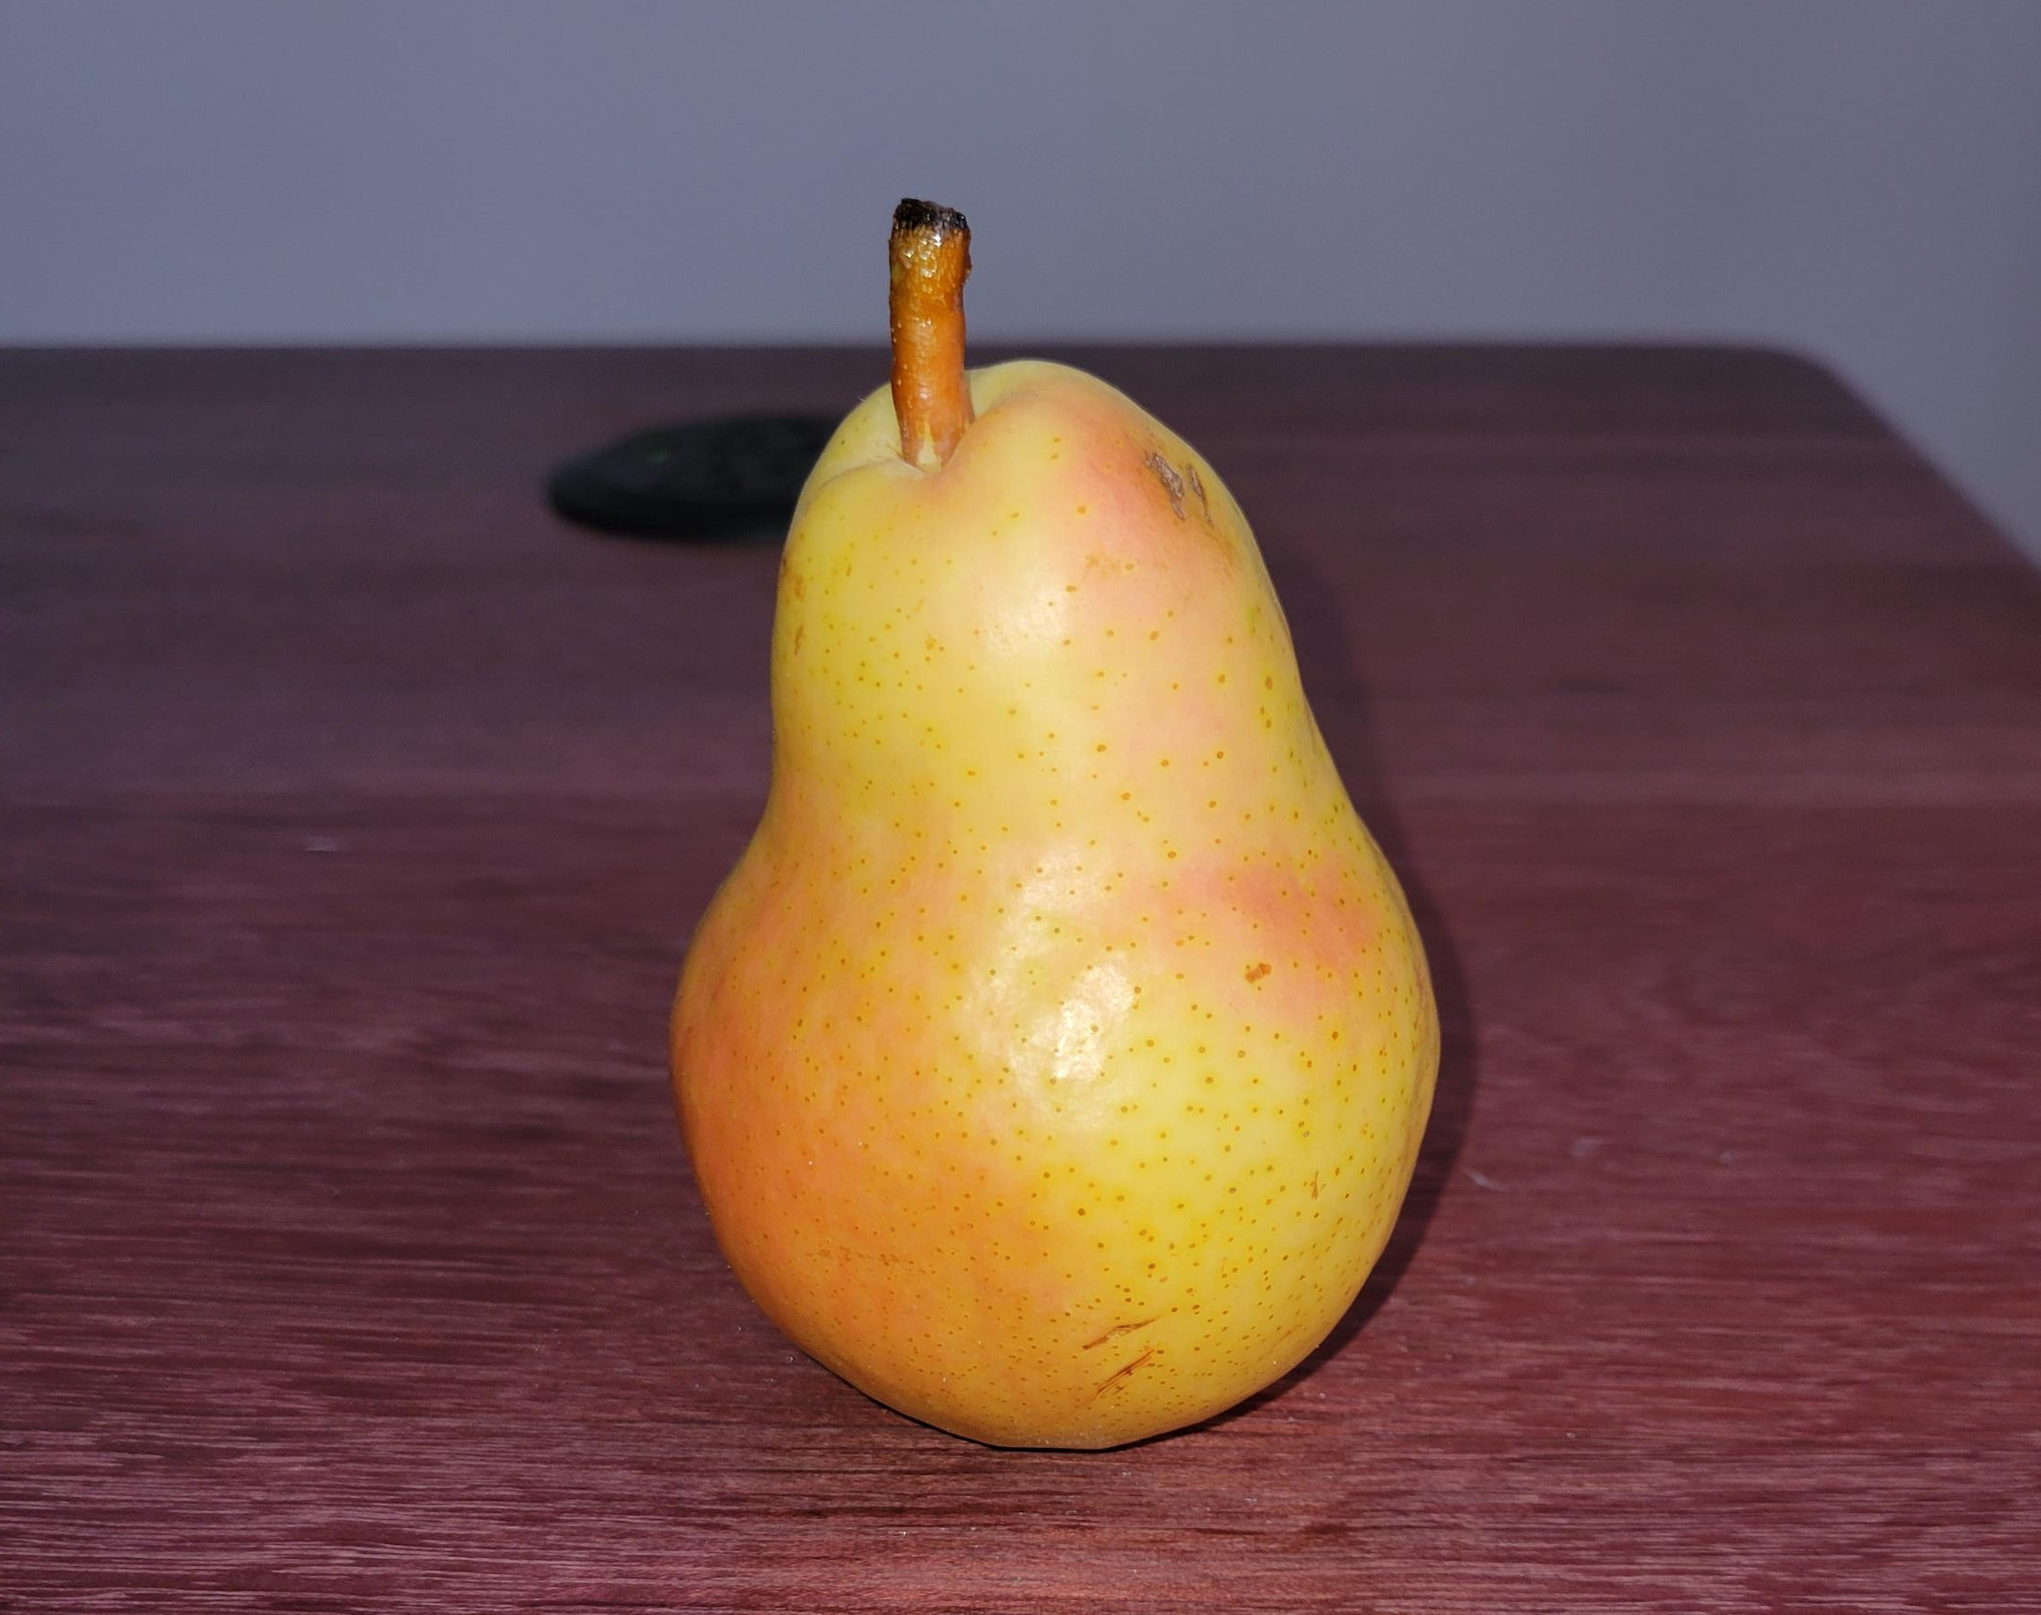
What is a pear?
Object VS Class

Slide 2
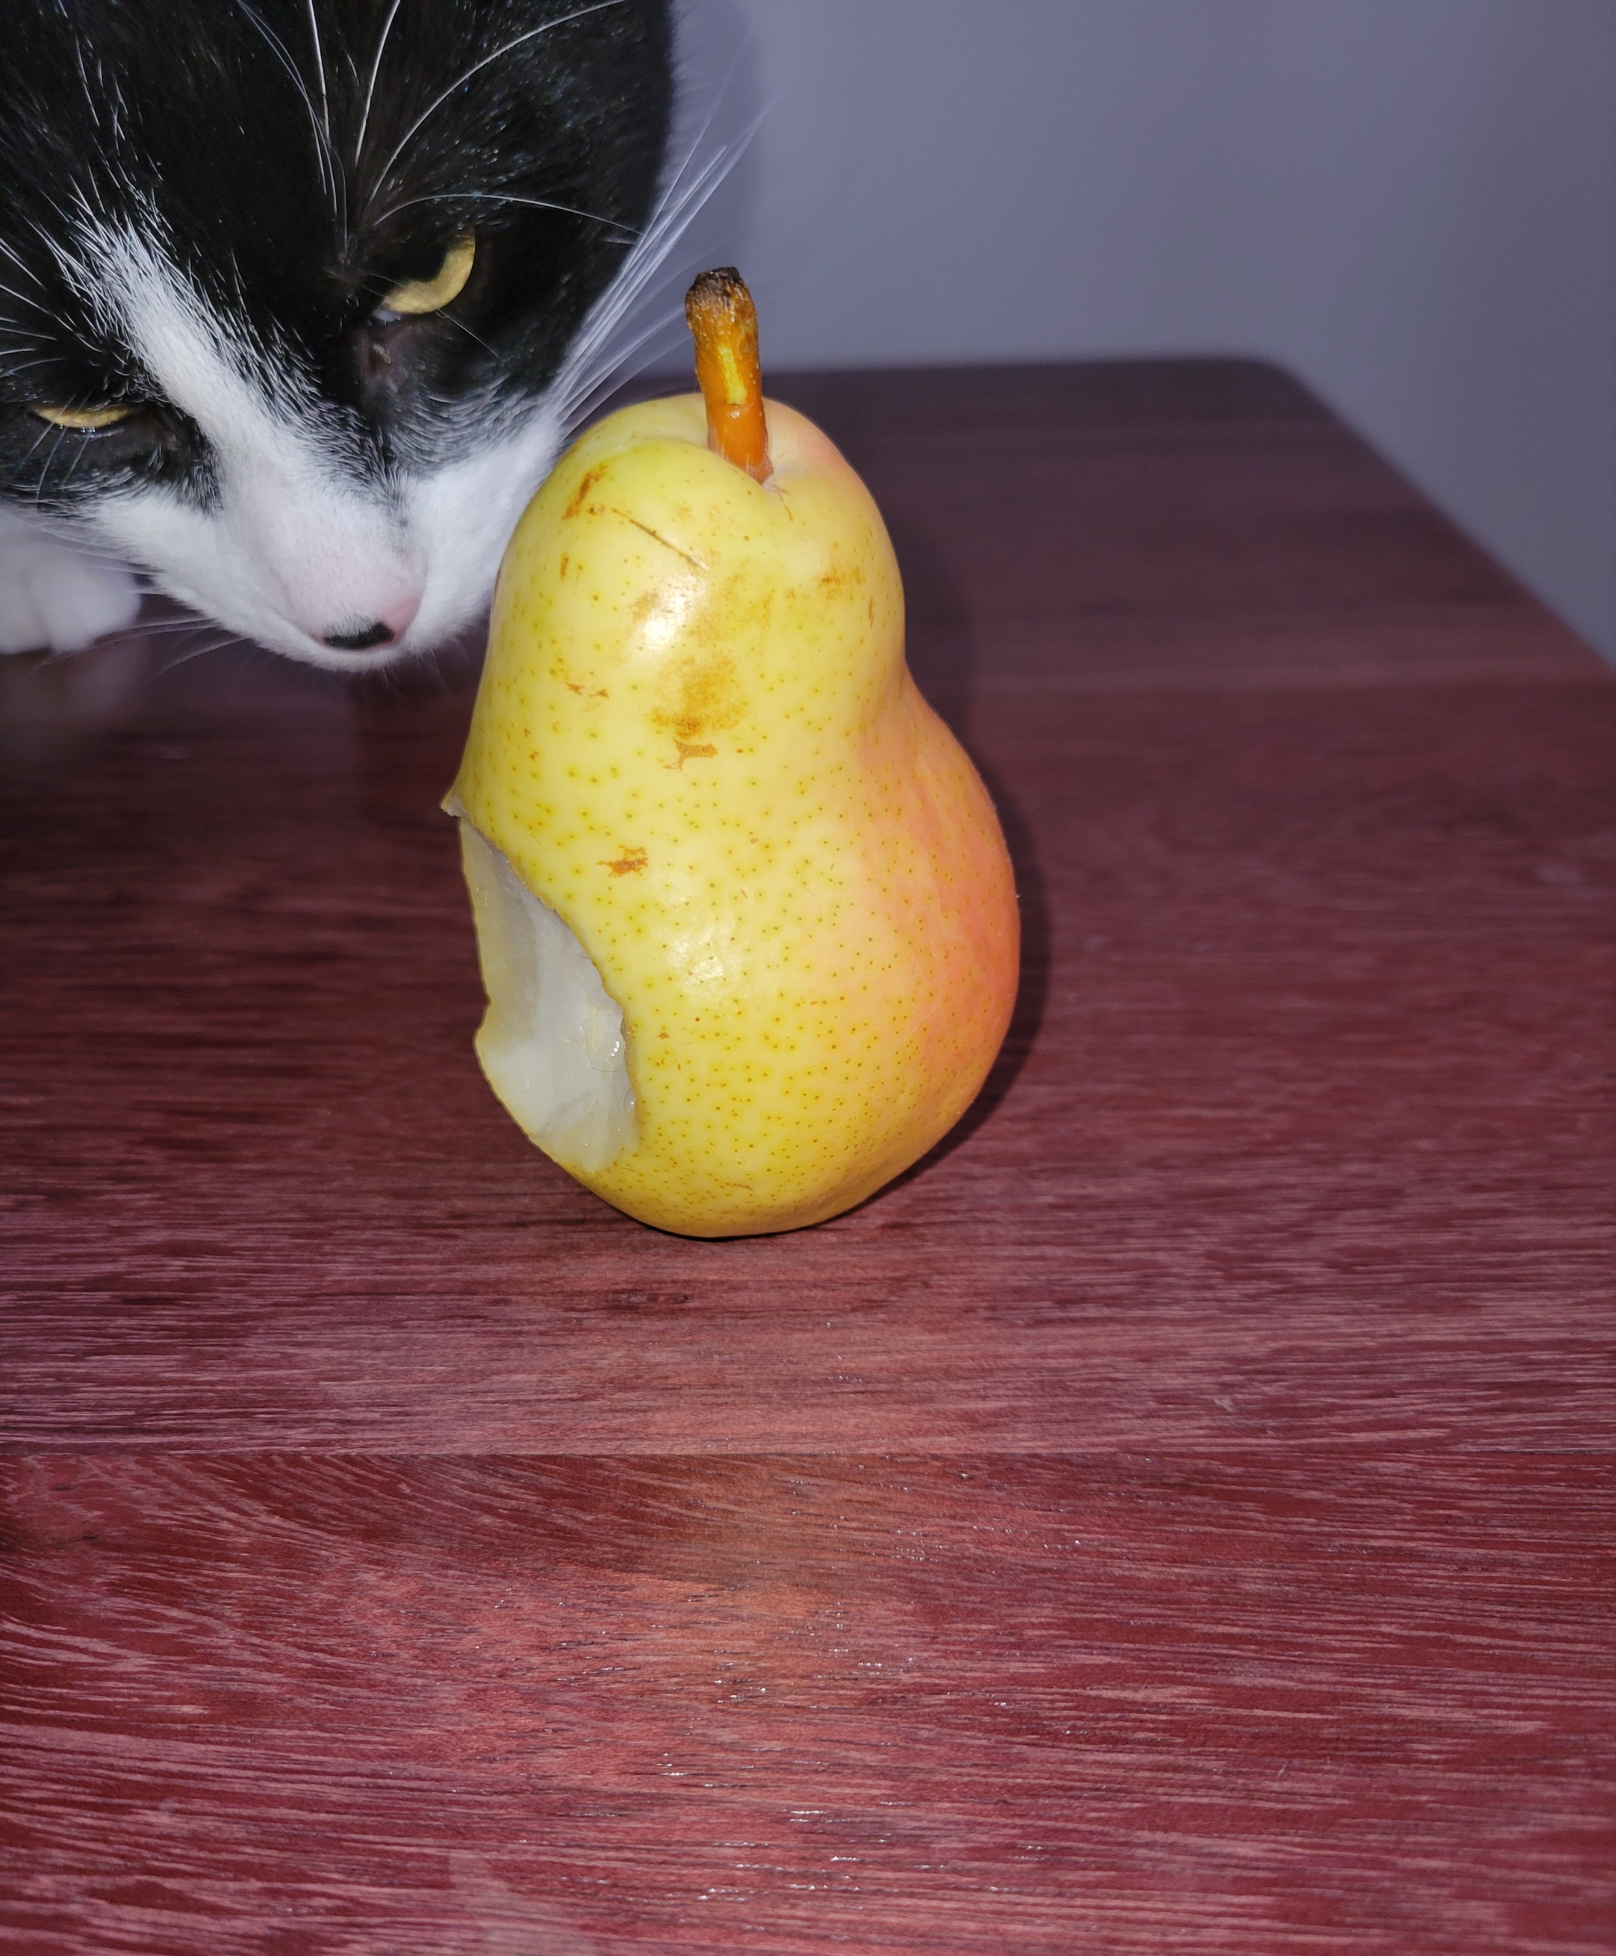
What is a pear?
The Object
This is a single pear out of an infinity of them.
Properties :
Its color
Is it fresh?
Is it eaten?
Is it been eaten?
...
Interaction
Eat
Dispose
Thrown
…

Slide 3

What is a pear?
The Class
This is a definitions of both the properties and interactions with a single pear.
Ask yourself: What do I (the program) need to interact with a single instance of pear?
Example:
Color : RBG|string|Enum
Void Eat(){…}

